Slide 1
Concept of the DarkNet
What is the DarkNet?

Slide 2
Table of contents
Presentation
Useful examples : advantages
Disadvantages

Slide 3
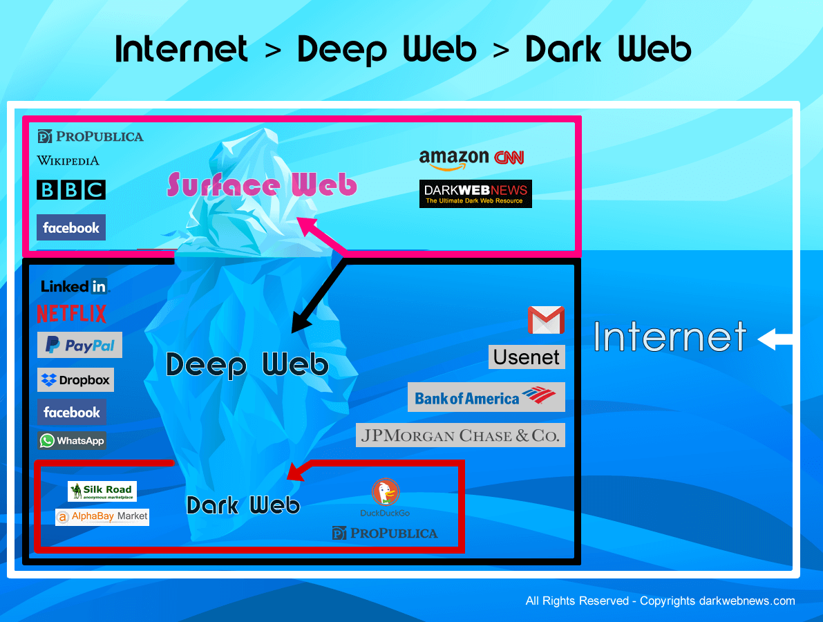
Presentation
Portions of internet not open to public view or hidden networks Originally described computers on ARPANET Url with .onion

Slide 4
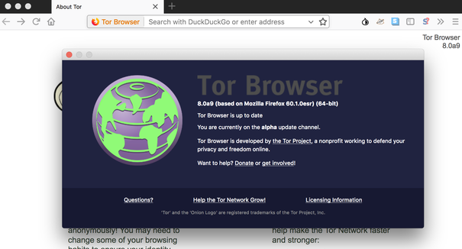



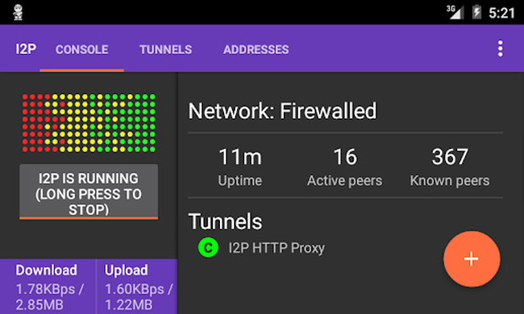
Needs
Computer
Bitcoin wallet
Cryptocurrency like bitcoin, monero , etherum TOR (the onion touter) or I2P (invisible internet project) cloack you and anonymazing

Slide 5
Advantages

Slide 6
Disadvantages
Contraband
Illegal services
Risk : caught with smuggle, get prosecution

